Slide 1
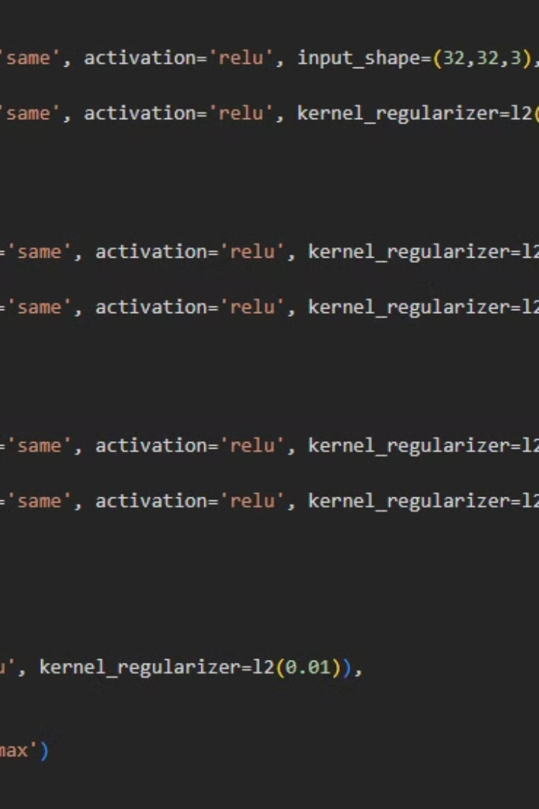

Deep Learning Image Classification Project Report
This report compares three image classification approaches using the CIFAR-10 dataset: a custom CNN architecture and two transfer learning methods using VGG16.
por Jose Ortiz

Slide 2
Methodology & Architecture Decisions
Custom CNN Architecture
Transfer Learning with VGG16
A VGG-style architecture with progressive depth, regularization techniques, and an optimization strategy.
Two approaches: basic transfer learning with frozen layers and fine-tuned transfer learning with unfrozen layers.

Slide 3
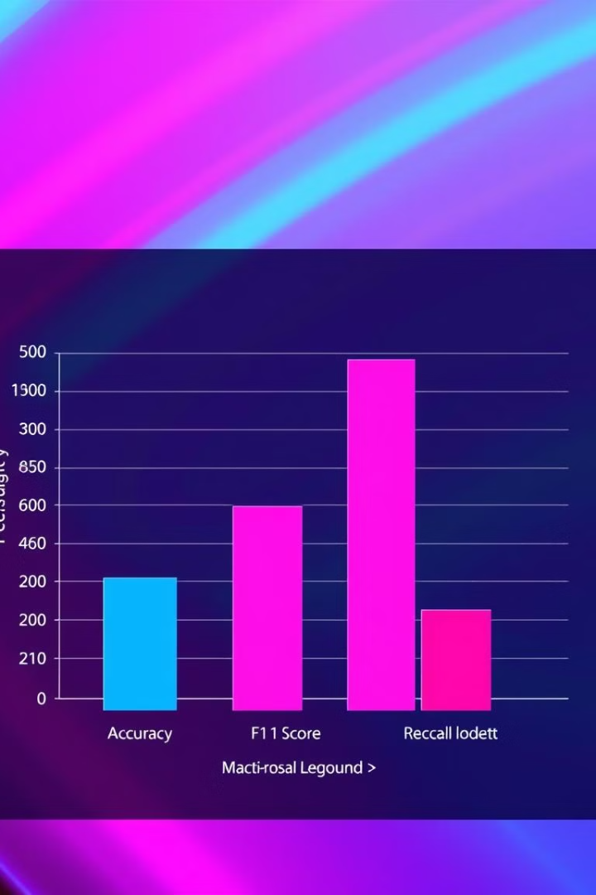
Results Analysis
88%
63%
Custom CNN
VGG16 Transfer
75%
VGG16 Fine-tuned

Slide 4
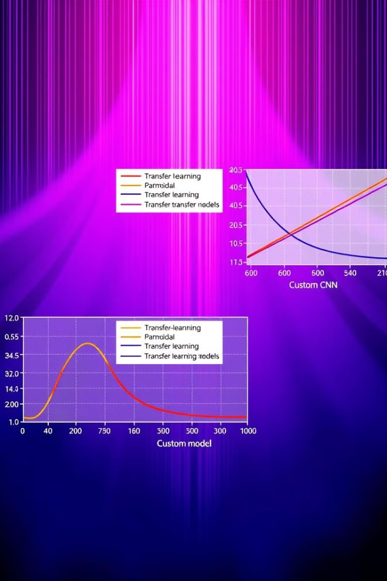
Findings
Custom CNN Performance
Basic Transfer Learning Limitations
Best overall performance (88% accuracy) with consistent metrics.
Unexpectedly lower performance (63% accuracy) due to possible reasons.
Fine-tuning Improvements
Significant improvement over basic transfer learning with a 12% accuracy increase.

Slide 5



Conclusion
Custom CNN
1
Most effective for this task.
Transfer Learning
2
Powerful but needs adaptation.
Dataset Characteristics
3
Consider model complexity.

